Slide 1
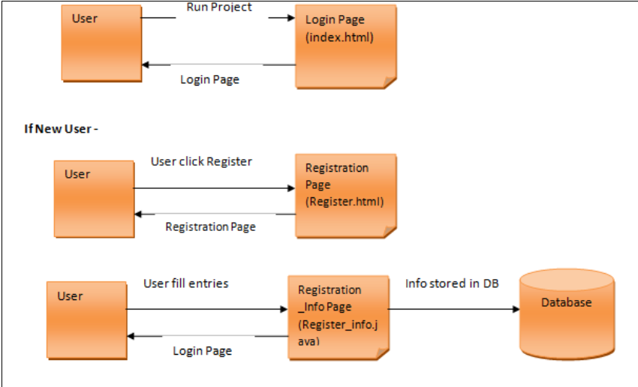
JDBC and Servlet -
This example will ask the user to login if the user is already registered, otherwise register yourself and then login based on the credentials specified at the time of registration.

Slide 2
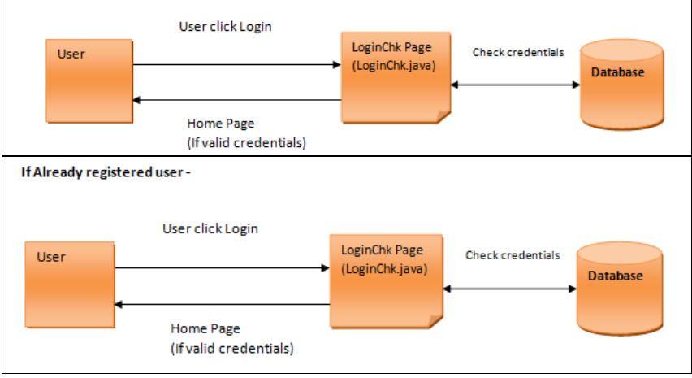

Slide 3
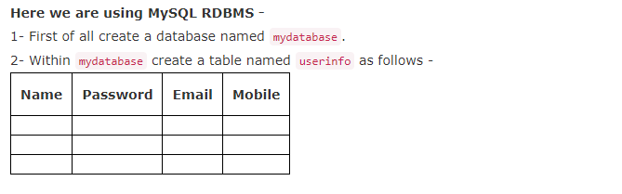
1- index.html or index.jsp - This will be your default page and Login Form
<!DOCTYPE html>
<html>
<head>
<title>JDBC and Servlet Demo</title>
</head>
<body>
<form method="get" action="LoginChk">
<table border="1px">

Slide 4
<tr>
<td>Enter Email -</td>
<td><input type="email" name="t1"></td>
</tr>
<tr>
<td>Enter Password -</td>
<td><input type="password" name="t2"></td>
</tr>
<tr>
<td><a href="Register.html">Register Here</a></td>
<td><input type="submit" value="Login"></td>
</tr>
</table>
</form>
</body>
</html>

Slide 5
2- Register.html - Create a html file named Register.html. It will be our Registration form.
<!DOCTYPE html>
<html>
<head>
<title>Registration Form</title>
</head>
<body>
<form method="post" action="Register_Info">
<table border="1px">
<tr>
<td>Name -</td>
<td><input type="text" name="t1"></td>
</tr>
<tr>
<td>Password -</td>
<td><input type="password" name="t2"></td>

Slide 6
</tr>
<tr>
<td>Email ID -</td>
<td><input type="email" name="t3"></td>
</tr>
<tr>
<td>Mobile -</td>
<td><input type="tel" name="t4"></td>
</tr>
<tr>
<td></td>
<td><input type="submit" value="Register"></td>
</tr>
</table>
</form>
</body>
</html>

Slide 7
3- Create a package named servs, and within that create the following servlets -
Register_Info Servlet - This servlet will be used to store user registration information into database.
package servs;
import java.io.*;
import javax.servlet.*;
import javax.servlet.http.*;
import java.sql.*;
public class Register_Info extends HttpServlet {
public void doPost(HttpServletRequest request, HttpServletResponse response)
throws ServletException, IOException {
response.setContentType("text/html;charset=UTF-8");
PrintWriter out = null;
try
{
out = response.getWriter();
String name = request.getParameter("t1");
String pass = request.getParameter("t2");
String email = request.getParameter("t3");
String mobile = request.getParameter("t4");
String dob = request.getParameter("t5");

Slide 8
Class.forName("com.mysql.jdbc.Driver");
Connection con = DriverManager.getConnection("jdbc:mysql://localhost:3306/mydatabase","root","");
PreparedStatement ps = con.prepareStatement("insert into userinfo (Name,Password,Email,Mobile) values (?,?,?,?)");
ps.setString(1, name);
ps.setString(2, pass);
ps.setString(3, email);
ps.setString(4, mobile);
int val = ps.executeUpdate();
if(val != 0)
{
out.println("<h1>Registered Successfully</h1>");
RequestDispatcher rdp = request.getRequestDispatcher("index.html");
rdp.include(request, response);
}
else
{
response.sendRedirect("Register.html");
}
}
catch(Exception ex)
{
out.println(ex);
}
}
}

Slide 9
LoginChk Servlet - This servlet will be used to check user email and password from database, If valid credentials provided by user, he will be redirected to Home page, otherwise Login page with error message will be displayed.
package servs;
import java.io.*;
import javax.servlet.*;
import javax.servlet.http.*;
import java.sql.*;
public class LoginChk extends HttpServlet {
public void doGet(HttpServletRequest request, HttpServletResponse response)
throws ServletException, IOException {
response.setContentType("text/html;charset=UTF-8");
PrintWriter out = null;
try
{
out = response.getWriter();
String email = request.getParameter("t1");
String pass = request.getParameter("t2");

Slide 10
Class.forName("com.mysql.jdbc.Driver");
Connection con = DriverManager.getConnection("jdbc:mysql://localhost:3306/mydatabase","root","");
PreparedStatement ps = con.prepareStatement("select * from userinfo where email=?");
ps.setString(1, email);
ResultSet rs = ps.executeQuery();
String dbpass = null;
if(rs.next())
{
dbpass = rs.getString(2);
}
if(pass.equals(dbpass))
{
response.sendRedirect("Home");
}

Slide 11
else
{
out.println("<h1 style = 'color:red'>Wrong username or password</h1>");
RequestDispatcher rdp = request.getRequestDispatcher("index.html");
rdp.include(request, response);
}
}
catch(Exception ex)
{
out.println(ex);
}
}
}

Slide 12
Home Servlet - This will be our home page, where user will reach if entered correct credentials.
package servs;
import java.io.*;
import javax.servlet.*;
import javax.servlet.http.*;
public class Home extends HttpServlet {
public void doGet(HttpServletRequest request, HttpServletResponse response)
throws ServletException, IOException {
response.setContentType("text/html;charset=UTF-8");
try
{
PrintWriter out = response.getWriter();
out.println("<h1 style='text-align:center; padding:10px'>Welcome to Home</h1>");
out.println("<hr>");
}
catch(Exception ex)
{
System.out.println(ex);
}
}
}

Slide 13
4 web.xml - Add the information of Servlets in web.xml as follows -
<web-app>
<servlet>
<servlet-name>Register_Info</servlet-name>
<servlet-class>servs.Register_Info</servlet-class>
</servlet>
<servlet-mapping>
<servlet-name>Register_Info</servlet-name>
<url-pattern>/Register_Info</url-pattern>
</servlet-mapping>
<servlet>
<servlet-name>LoginChk</servlet-name>
<servlet-class>servs.LoginChk</servlet-class>
</servlet>
<servlet-mapping>
<servlet-name>LoginChk</servlet-name>
<url-pattern>/LoginChk</url-pattern>
</servlet-mapping>

Slide 14
<servlet>
<servlet-name>Home</servlet-name>
<servlet-class>servs.Home</servlet-class>
</servlet>
<servlet-mapping>
<servlet-name>Home</servlet-name>
<url-pattern>/Home</url-pattern>
</servlet-mapping>
</web-app>

Slide 15
Note - Do not forgot to include MySQL Connector jar file into your project.
Now run the project and it will show you Login form as follows -

